Slide 1
Paging
Paging is a memory management technique in which process address space is broken into blocks of the same size called pages (size is power of 2, between 512 bytes and 8192 bytes). The size of the process is measured in the number of pages.
Similarly, main memory is divided into small fixed-sized blocks of (physical) memory called frames
And the size of a frame is kept the same as that of a page to have optimum utilization of the main memory and to avoid external fragmentation.

Slide 2
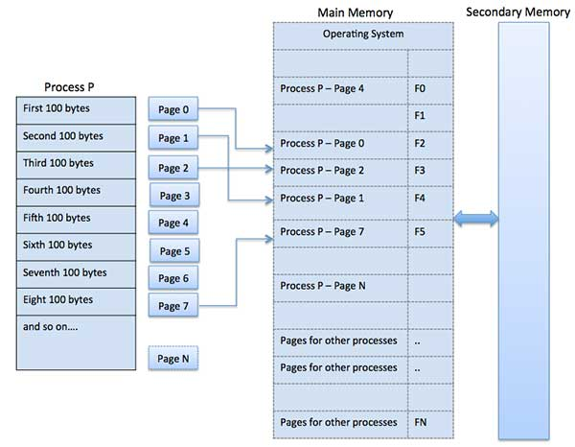

Slide 3
Address Translation
Page address is called logical address and represented by page number and the offset.
Logical Address = Page number + page offset
Frame address is called physical address and represented by a frame number and the offset.
Physical Address = Frame number + page offset
A data structure called page map table is used to keep track of the relation between a page of a process to a frame in physical memory.

Slide 4
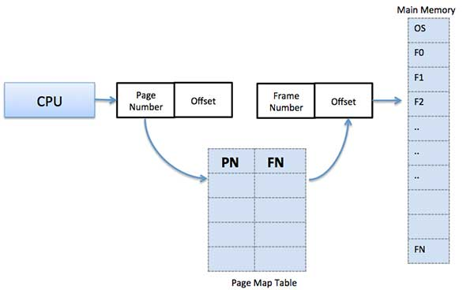

Slide 5
Advantages and Disadvantages of Paging
1.Paging reduces external fragmentation, but still suffer from internal fragmentation.
2.Paging is simple to implement and assumed as an efficient memory management technique.
3.Due to equal size of the pages and frames, swapping becomes very easy.
4.Page table requires extra memory space, so may not be good for a system having small RAM.

Slide 6
Demand Paging
A demand paging system is quite similar to a paging system with swapping where processes reside in secondary memory and pages are loaded only on demand, not in advance.

Slide 7
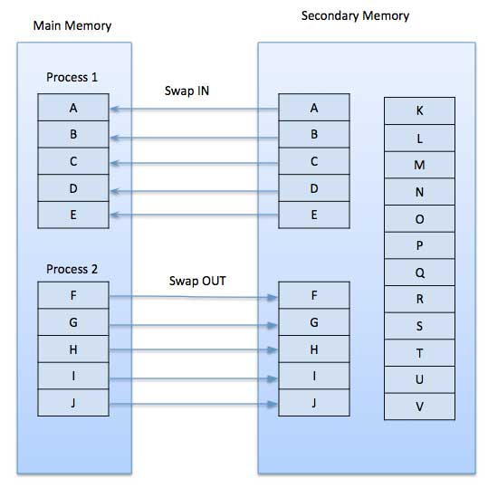

Slide 8
Advantages
Large virtual memory.
More efficient use of memory.
There is no limit on degree of multiprogramming.
Disadvantages
Number of tables and the amount of processor overhead for handling page interrupts are greater than in the case of the simple paged management techniques.

